Slide 1
Instructions
Fill in the two circles about what you are good at, and what makes you happy
Check out the SMALEI matrix areas and sub-areas to help answer “what needs doing?”. The aspects are the most specific level, and this could help you decide what needs doing in your community, institution, home or other space. Links to these areas in an interactive version are available in slides 5 – 10.
Consider your climate action sweet spot: how can you bring together these aspects to work on your identified priority?

Slide 2


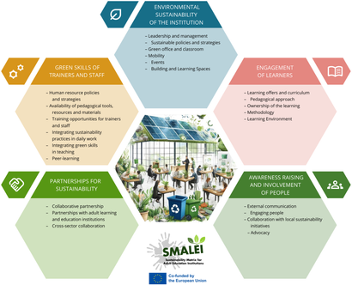


Your climate sweet spot
What brings you joy?
based on Ayana Elizabeth Johnson’s climate action sweet spot
What brings you joy?
In life
In work
As a person
What needs to be done? (Explore the Matrix)
What can you do, now? In the future?
What are you good at?
Are any of these areas the most important for you?
Partnerships for Sustainability
Green Skills
Engagement of learners
Awareness Raising and Involvement of People
Environmental sustainability of the institution
Skills
Resources
Networks

Slide 3
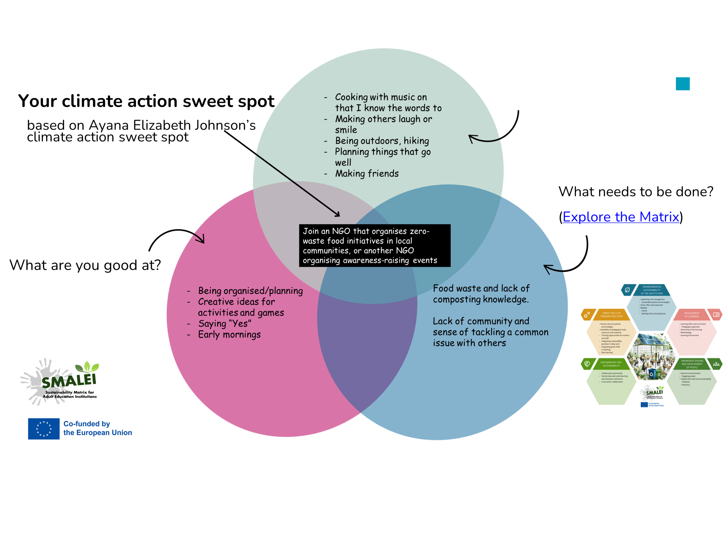
EXAMPLE

Slide 4
Environmental sustainability of the institution – SMALEI
Engagement of learners – SMALEI
Awareness-raising and involvement of people – SMALEI
Partnerships for sustainability – SMALEI
Green skills of trainers and staff – SMALEI

Slide 5
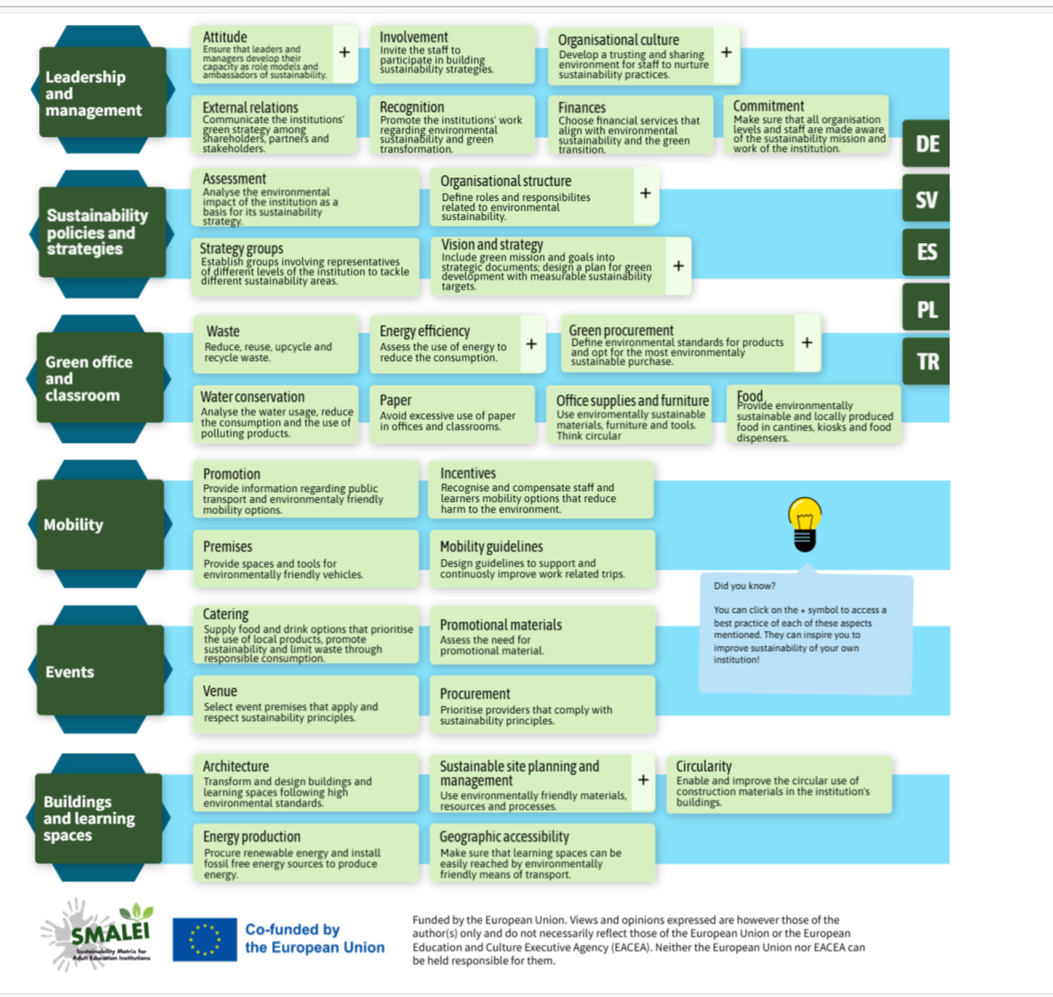
SMALEI Matrix - Environmental Sustainability of the Institution

Slide 6
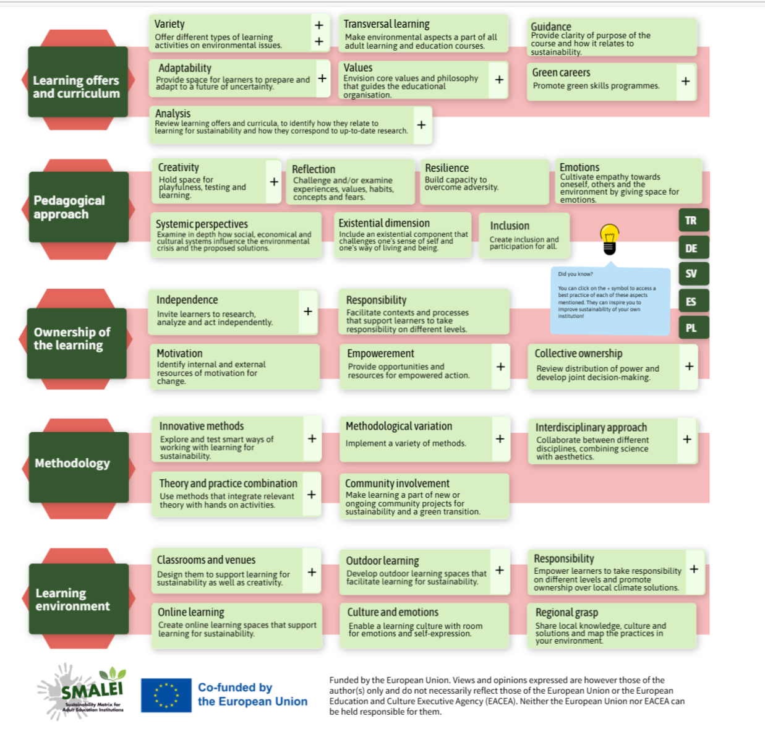
SMALEI Matrix - Engagement of learners

Slide 7
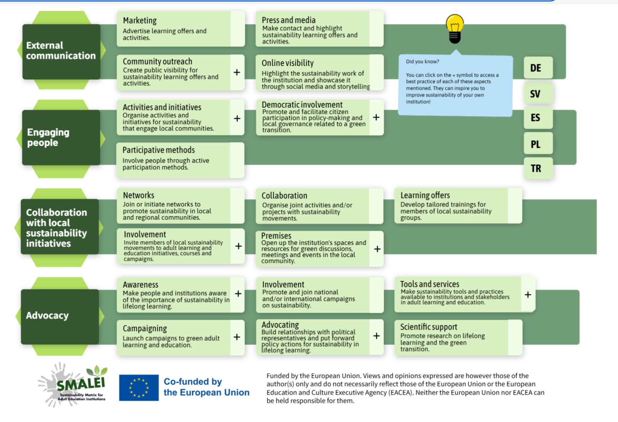
SMALEI Matrix - Awareness Raising and Involvement of People

Slide 8
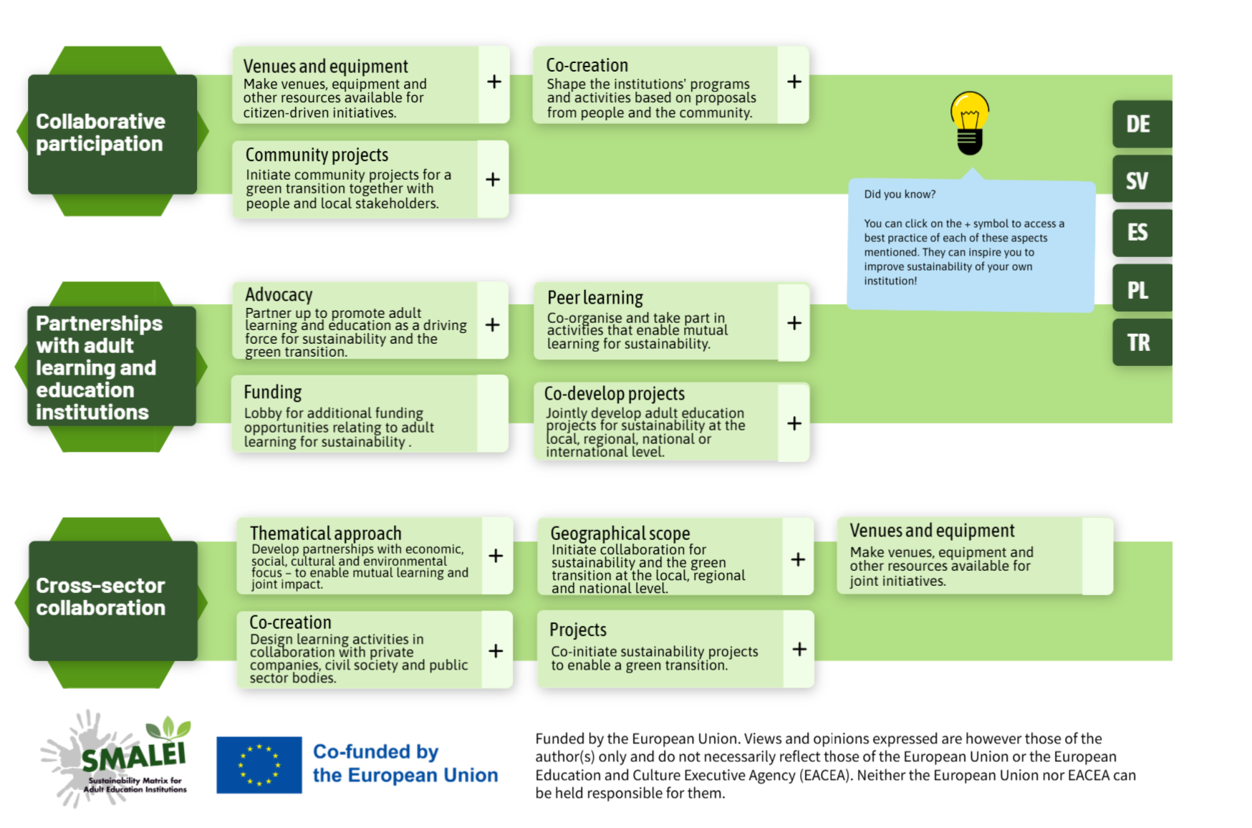
SMALEI Partnerships

Slide 9
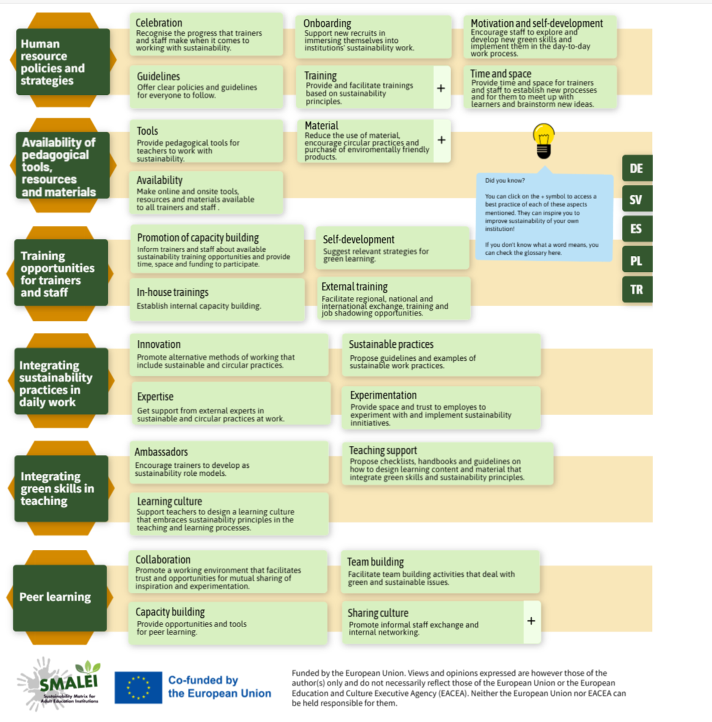
SMALEI Matrix - Green Skills of Trainers and Staff

